Slide 1
REMOTE REPOS & GITHUB
https://github.com/tnt-summer-academy/Curriculum-202
Created for Microsoft / TNTs
Notes:
http://bit.ly/supdecogit

Slide 2
Learning Objectives
Understand why we use branches and practice with them.
Understand the basic workflow for how multiple people work with Git.
Learn to clone a repository, push changes, make a pull request.
Learn to stash changes
Learn how to create and use repositories on GitHub.

Slide 3
PART 1 WORKING WITH A REMOTE REPOSITORY

Slide 4
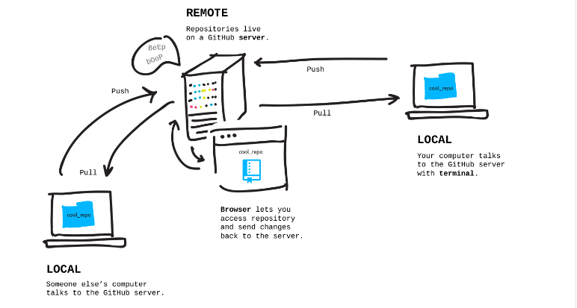

Slide 5
PART 2 CLONE

Slide 6
Scenario 1a: Clone an existing repository
Go to the terminal
Make a new directory: mkdir Local
cd Local
Clone the Exercises repository using
git clone https://github.com/tnt-summer-academy/Exercises.git
cd Exercises
On what branch are you?
Already done several times

Slide 7
Scenario 1b: Create and clone a repository
Go to GitHub
Create a repository (private) Remote initialized with a README.md file
Go to the terminal
Make a new directory: mkdir Local
cd Local
Clone the remote repository in Remote using
git clone https://github.com/yourpseudo/Remote.git
cd Remote
On what branch are you?

Slide 8
PART 3
CLONE IN VS CODE

Slide 9
Scenario 1c: Clone a repository in VS Code
Already done several times

Slide 10
PART 4
PUSHING CHANGES

Slide 11
Scenario 2: Push changes to GitHub
In the terminal
Change the README.md file and add a file (e.g., index.html) locally
Commit your changes
git add .
git commit –m "add index.html and correct README.md"
Showing the remote
git remote
git remote show origin
Push the changes to the remote in GitHub
git push origin main
Check GitHub

Slide 12
git push origin main
Takes the local commits (of the main branch) and upload them to the remote server (origin) on GitHub on the (main) branch

Slide 13
PART 5
BRANCHES

Slide 14
Why branches ?
Branching is appropriate to support collaboration between developers when some will fix bugs, some will work on new features, some will refactor code etc.
It allows each developer to branch out from the original code base and isolate their work from others
It also helps Git to easily merge versions later on
main is (often) the default branch
HEAD is a pointer to the branch you are currently on

Slide 15
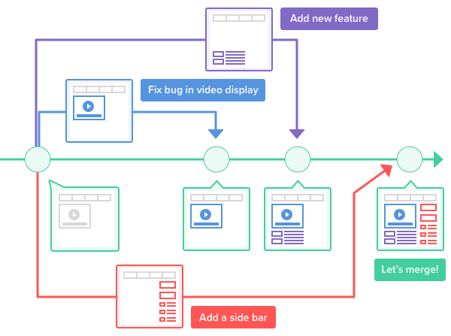
Multiple development projects taking place using the same source code.
https://backlog.com/git-tutorial/using-branches

Slide 16
Create a branch
Create a branch
git branch develop
Use the branch
git checkout develop
or in one line
git checkout –b develop
Give good names to branches!

Slide 17
Scenario 3: Create a branch and push work to this branch in GitHub
Create a branch: develop and go to this branch
git branch develop
git checkout develop
Make some local changes in index,html
Commit the changes
Switch to the main branch
git checkout main
Look at the content of index.html
Switch back to the develop branch
git checkout develop
Look at the content of index.html
Push the branch to the remote repository (u = upstream, when you make your first push to track à remote branch)
git push –u origin develop
Pull the changes from remote (made by other developers) before making any commit
git pull [nothing to pull here but do it as an habit]
What is happening in GitHub?

Slide 18
Other commands on branches
View all the branches and on what branch you are
git branch
View remote tracking and local branches
git branch –a
Rename a branch
git branch –m oldbranchname newbranchname
Delete a branch
git branch –d branchname
You cannot be on the branch you want to delete!

Slide 19
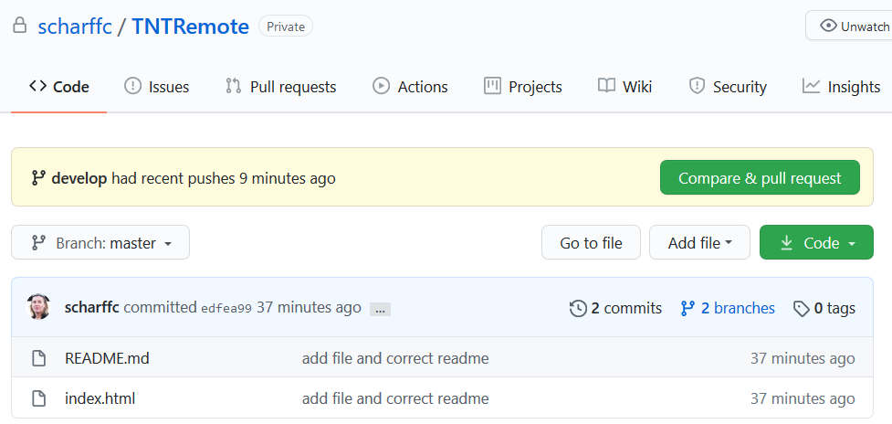
Scenario 4: Demo of the pull request in GitHub
In GitHub, a pull request appears!
Click on Compare & pull request
Explore and merge the pull request

Slide 20
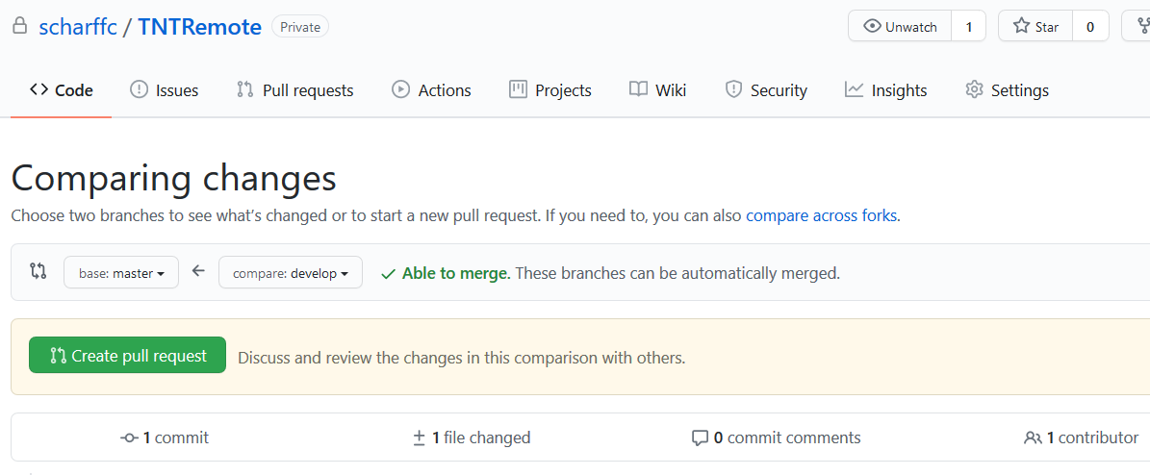
Scenario 5: Pull the changes locally and create one more pull request
Pull the files on main
git checkout main
git pull
On the develop branch, work on the files locally, make changes and commit them
Push the changes
git push origin develop
Go to GitHub, create a pull request
using the interface and merge it

Slide 21
GitHub workflow
https://guides.github.com/introduction/flow/

Slide 22
PART 6 CREATE AND USE A REPO ON GITHUB

Slide 23
Scenario 6: Create and use a repository on GitHub
Create a repository on GitHub with Readme.md
Clone the repository locally
Do some changes and commit them (using the terminal)
Push the changes to GitHub
Continue making changes
Post a screenshot from GitHub (in your team channel)

Slide 24
Scenario 7: Delete index.html in GitHub
We will delete a remote file that is local too!
In the terminal do the following:
On the develop branch in the terminal
git rm index.html
git add .
git commit –m "delete index.html on develop"
git push origin develop
Do the pull request in GitHub (if you do not see it go to the Pull request menu)
Go back to the terminal
git checkout main
git pull

Slide 25
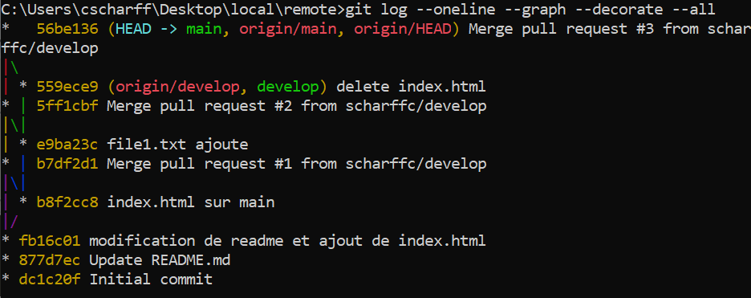
Other commands
git diff HEAD
git diff --staged
git log --oneline
git log --oneline --graph --decorate --all

Slide 26
GitHub workflow
https://guides.github.com/introduction/flow/

Slide 27
PART 7 STASH
When you switch between branches, either you committed your code or you need to stash your code to save your code in progress

Slide 28
Scenario 8: Stash a work-in-progress and switch between branches
We use stash to save work that is not committed and when we want to switch between branches and not lose work
In the terminal do the following:
On the develop branch in the terminal
Go the the develop branch and edit a file on that branch
git stash
Switch branch to main using git checkout main
Go back to the develop branch
Type git stash list
Pop the work using git stash pop
Commit the work

Slide 29
PART 8 REVIEW TROUBLE SPOTS

Slide 30
Review trouble spots
What is going well?
What do you have difficulties with?
Google your error messages!

